Slide 1
FINAL INTERNSHIP REVIEW AAYUSH MITTAL
5 July 2019

Slide 2
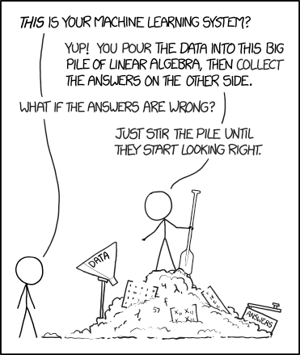

WALK THROUGH TIMELINE (1/2)
WEEK 1
WEEK 1
DEFINITION OF SCOPE
Research the need, uses, advantages and techniques available.
WEEK 2
RESEARCH ON TECHNIQUES
Detailing the pros and cons of ELI5 and LIME and implementing on sample data .
WEEK 3
RESEARCH ON TECHNIQUES
Detailing the pros and cons of SHAP(TreeExplainer) and implementing on sample data .
WEEK 4
RESEARCH ON TECHNIQUES
Detailing the pros and cons of SHAP(DeepExplainer) and implementing on sample data .

Slide 3
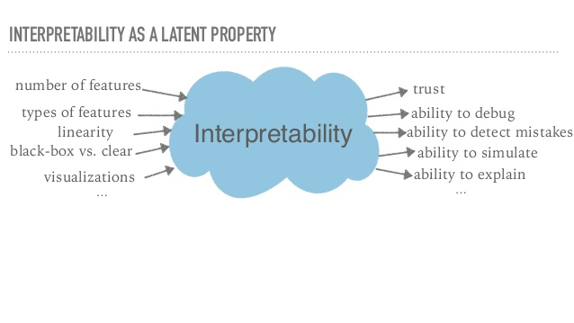

WALK THROUGH TIMELINE (2/2)
WEEK 1
WEEK 5
INTERIM REPORT
Preparing report presentation.
WEEK 6
IMPLEMENTATION
Implementing shortlisted techniques on models developed in labs.
WEEK 7
DOCUMENTATION
Preparing documentation for knowledge transfer.

Slide 4
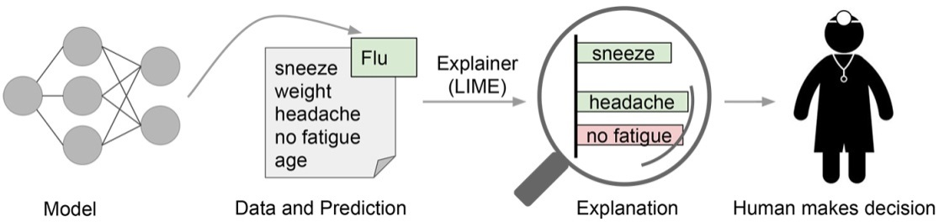
ABSTRACT
Model Interpretability of complex models has always been a limiting factor for use cases requiring explanations of the features involved in modelling and such is the case for many industries such as Financial and Medical Services. Financial institution whether by regulation or by choice prefer structural models that are easy to interpret by humans that’s why deep learning models within these industries have had slow adoptions. An example of a critical use case would be risk models where usually banks prefer classic statistical methods such as Generalized Linear Models, Bayesian Models, etc. that are easily explainable and interpret in terms of human intuition.
Interpretability since the beginning has been an important area of research since Deep Learning models can achieve high accuracy but at the expense of high abstraction. This is important also because of Trust since a model that is not trusted is a model that will not be used.

Slide 5
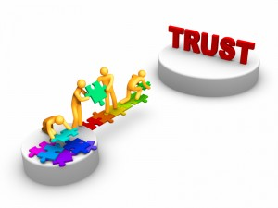

HOW THIS INITIATIVE CAN HELP NAVIK PLATFORM?
Will help in developing Trust in the Machine Learning models by making algorithms as transparent as possible.
Will help in debugging model.
Will help building Trust over clients too.
Give scope to improve our predictions.
Most importantly, this will help us to justify as well explain our model prediction to the clients.

Slide 6
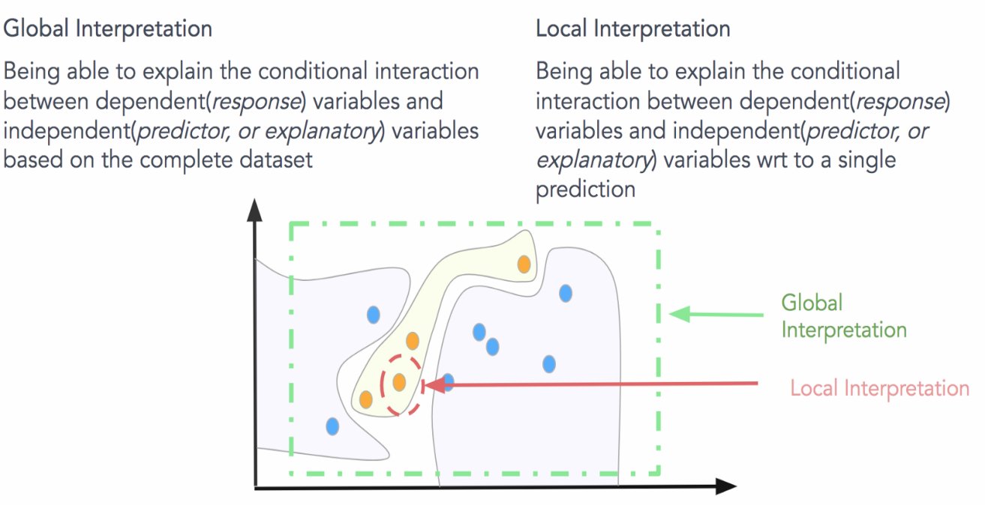
TYPES OF INTERPRETABILITY
Local Interpretability
LIME
ELI5
SKATER
SHAP, etc.
Global Interpretability
XgBoost
ELI5- Permutation Importance
SHAP
PD plots, etc.
Two most important Model Interpretors are LIME and SHAP.

Slide 7
TECHNIQUES
ELI5 – Permutation Importance
LIME
SHAP
Definition
Definition
Definition
ELI5 Permutation Importance provides a way to compute feature importance for any black-box estimator by measuring how score decreases when a feature is not available. It only shows the magnitude of importance.
LIME (Local Interpretable Model-agnostic Explanations) creates dataset in locality of our observation by perturbation the different features. Then it fits a local linear model on this data and uses the weight on each feature to provide an explanation.
SHAP (SHapley Additive exPlanation) connects cooperative game theory with explanation.
TreeExplainer - Optimized for XGBoost, LGB,
DeepExplainer - Optimized for Deep Models
Kernel Explainer - Model agnostic
Characteristics
Characteristics
Characteristics
Model Agnostic
Global Interpretation
Model Agnostic
Local Interpretation
Model Agnostic
Local and Global Interpretation
Limitation
Limitation
Limitation
It does not shows the direction of importance.
Also, it does not takes account of correlation between features into its importance.
As it uses random sampling of new points it is little unstable.
Also, it fits a linear model to the new dataset generated it is slightly inaccurate.
SHAP as Kernel Explainer is extremely slow, so for models like SCM, KNN, etc. using LIME or ELI5 will be better choice.

Slide 8
DATASET

Slide 9
Data used for local interpretation
(A)
(B)

Slide 10
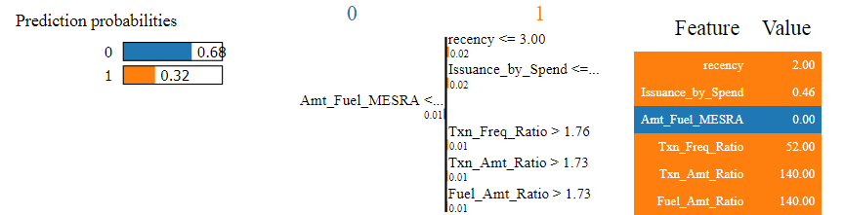
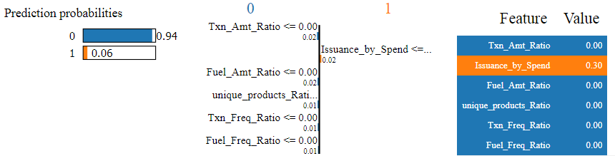
LOCAL INTERPRETATION (1/2)
TECHNIQUE – LIME
MODEL – RF(A), RF(B)
(A)
(B)
SOURCE CODE

Slide 11
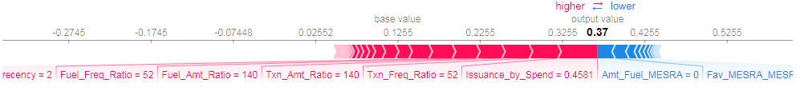
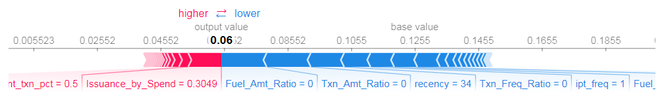
LOCAL INTERPRETATION (2/2)
TECHNIQUE – SHAP
MODEL – RF(A),RF(B)
(A)
(B)
SOURCE CODE

Slide 12
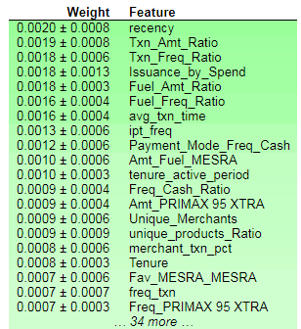
GLOBAL INTERPRETATION (1/2)
TECHNIQUE – PERMUTATION IMPORTANCE
MODEL – RANDOM FOREST
SOURCE CODE

Slide 13
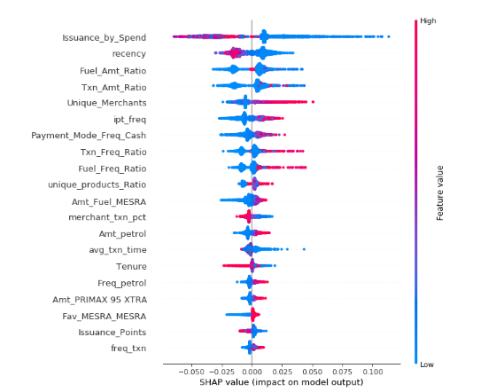
GLOBAL INTERPRETATION (2/2)
TECHNIQUE – SHAP(TREEEXPLAINER)
MODEL – RANDOM FOREST
SOURCE CODE

Slide 14
WHICH TECHNIQUE SHOULD WE USE?
Each technique ELI5 Permutation Importance, SHAP and LIME have their own sets of strengths and limitation. ELI5 is generally less preferable as there is lack of directionality in this technique and it is also a slow technique.
Between SHAP and LIME using SHAP is better choice because of the following three points:-
More solid theoretical foundation: As we know LIME uses random sampling of permuted data which makes it little unstable and unpredictable and also it fits a linear model to the new dataset generated which makes it slightly inaccurate while SHAP uses a theoretically strong concept of Game Theory.
Highly optimized: Using SHAP comes in very handy when we applied Tree or Neural Network models on our dataset because explainer like TreeExplainer, DeepExplainer are highly optimized for these models.
And lastly, we can get both local and global interpretation of our models with greater insights using the interactive graphs provided by the force_plot in SHAP.
Using SHAP as KernalExplainer is highly computational expensive and thus not preferable to use. LIME on other hand is handy to use with models like SVM, KNN, Naive Bayes etc. because SHAP is not optimized for this machine learning models. LIME’s local interpretation also provides a bit more detail than that of SHAP as it specifies a range of feature values that are causing that feature to have its influence.

Slide 15
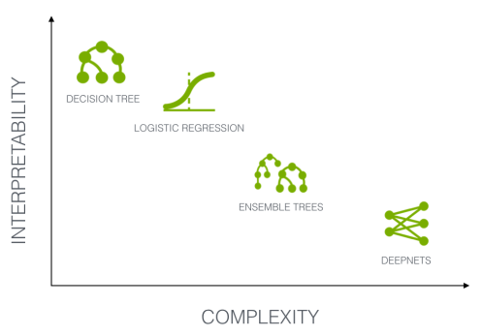
CHALLENGES & FUTURE SCOPE
Challenges
Still a area of heavy research.
Lack of information online.
Complex to work on categorical features.
Future Scope
The need to explain black box models will only increase as time goes on because models get more complex with time. There is a growing concern around the acceptance of AI agents and trust issues due to their lack of explainability. For many years, priority has been given to the performance over the interpretability leading to huge advancements in several fields including computer vision, natural language processing and sequence modeling. However, the crucial questions driven by the reluctance to accept AI-based decisions may lead to a whole new dynamic where explainability may be among the key measures for evaluating models. I believe that in the not too distant future we will find that model explainability will become a standard part of data science work.

Slide 16
REFERENCES
https://www.oreilly.com/ideas/testing-machine-learning-interpretability-techniques
https://github.com/slundberg/shap
https://towardsdatascience.com/interpretability-of-deep-learning-models-9f52e54d72ab
https://github.com/slundberg/shap
https://learning.oreilly.com/library/view/an-introduction-to/9781492033158/ch01.html
https://github.com/klemag/PyconUS_2019-model-interpretability-tutorial/blob/master/helpers.py
https://github.com/slundberg/shap#citations
https://github.com/klemag/PyconUS_2019-model-interpretability-tutorial/blob/master/Model%20Interpretability.pdf
https://www.kaggle.com/dansbecker/shap-values
https://homes.cs.washington.edu/~marcotcr/blog/lime/
Link to all Documents. (Knowledge Transfer)

Slide 17
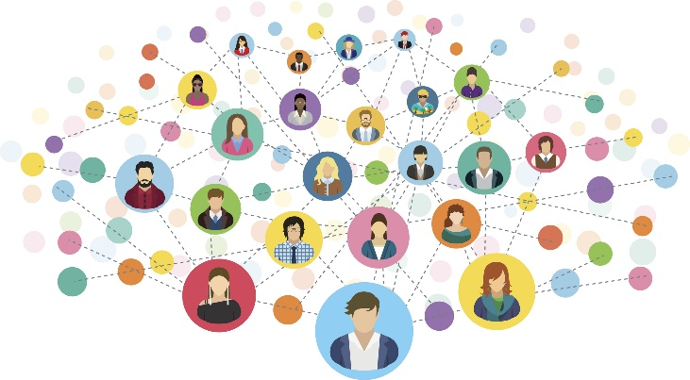
EXPERIENCE SO FAR
Learnt a lot of things including -> Technical skills -> Corporate life
Determined my interests.
Made a lot of friends and built connections

